Slide 1
Unit 1
NATURE OF BUSINESS

Slide 2
BUSINESS
Wheeler –”An institution organized and operated to provide goods & services to the society under the incentive of private gain”
“Business may be defined as human activities directed towards providing or acquiring wealth through buying and selling good”

Slide 3
WHAT IS BUSINESS?
Business may be defined as an economic activity involving the purchase, production and sale of goods and services with a motive of earning profits by satisfying human wants.
Economic system in which goods and services are exchanged for one another or money, on the basis of their perceived worth.
Every business requires some form of investment and a sufficient number of customers to whom its output can be sold at profit on a consistent basis.
An activity engaged in as means of livelihood or profit or an entity which engages in such activities
Notes:
Definition
Economic system in which goods and services are exchanged for one another or money, on the basis of their perceived worth. Every business requires some form of investment and a sufficient number of customers to whom its output can be sold at profit on a consistent basis
"The simplest definition of business is you solve a customer's problem and create sustainable profits over time. Anyone with vision should understand the problem they're solving. The problem with business today is that people think the meaning is about building a monument to yourself. The meaning of business is having an impact on people's lives." My definition was close:
A business' purpose is to attract and keep customers. Its one basic function is to reliably solve customer problems...
The occupation, work, or trade in which a person is engaged: the wholesale food business.
Investment Dictionary: Business
1. An organization or enterprising entity engaged in commercial, industrial or professional activities. A business can be a for-profit entity, such as a publicly-traded corporation, or a non-profit organization engaged in business activities, such as an agricultural cooperative. 2. Any commercial, industrial or professional activity undertaken by an individual or a group. 3. A reference to a specific area or type of economic activity.
Investopedia Says: 1. Businesses include everything from a small owner-operated company such as a family restaurant, to a multinational conglomerate such as General Electric. 2. To "do business" with another company, a business must engage in some kind of transaction or exchange of value with that company. 3. In this sense, the word "business" can be used to refer to a specific industry or activity, such as the "real estate business" or the "advertising business".
.
A business (also known as a company, enterprise, and firm) is a legally recognized organization designed to provide goods or services, or both, to consumers, businesses and governmental entities.^{[1]} Businesses are predominant in capitalist economies. Most businesses are privately owned. A business is typically formed to earn profit that will increase the wealth of its owners and grow the business itself. The owners and operators of a business have as one of their main objectives the receipt or generation of a financial return in exchange for work and acceptance of risk. Notable exceptions include cooperative enterprises and state-owned enterprises. Businesses can also be formed not-for-profit or be state-owned.
The etymology of "business" relates to the state of being busy either as an individual or society as a whole, doing commercially viable and profitable work. The term "business" has at least three usages, depending on the scope — the singular usage (above) to mean a particular company or corporation, the generalized usage to refer to a particular market sector, such as "the music business" and compound forms such as agribusiness, or the broadest meaning to include all activity by the community of suppliers of goods and services. However, the exact definition of business, like much else in the philosophy of business, is a matter of debate and complexity of meanings.
What is business? A business can be defined as an organization that provides goods and services to others who want or need them. When many people think of business careers, they often think of jobs in large wealthy corporations. Many business-related careers, however, exist in small businesses, non-profit organizations, government agencies, and educational settings. Furthermore, you don't need a degree in business to obtain many of these positions. In short, every sector of our economy needs people with strong overall skills that can be applied to business-type careers. There are a wide variety of career areas that exist in business settings. Some of these include:
Accounting
Administrative management
Business management
Finance
Human resources
Information systems
Insurance
Marketing
Operations management
Public relations
Purchasing/merchandising
Retail management
Sales

Slide 4
WHAT IS A BUSINESS?
A decision-making organization involved in the process of using inputs to produce good and/or provide services.
Businesses exist to satisfy the needs and wants of people, organizations, and governments.
Peter Drucker: the only purpose of a business is to create customers.
Drucker is considered the “father of modern management” and wrote nearly 40 business books

Slide 5
WHAT DO BUSINESSES DO?
Businesses process inputs to create goods or services
Goods are physical products
Consumer goods – purchased by general public; can be durable or non-durable
Capital goods – purchased by businesses
Services are intangible products
Businesses contribute a “value added” that enhances the value of the inputs and produces profit for the business

Slide 6
Understanding The Business System
Old concept of Business:
The exclusive objective of business in those was maximization of profit at any cost.
Business begin merely as an as an institution for the purpose of making money.
As long as one made money and kept himself out of jail he was considered as successful.
He felt no particular obligation and acknowledged NO responsibility to the community.

Slide 7
New concept of Business:
The modern business enterprise is social & economic institution .
Business by itself is not an end but a means to achieve an end ,a means to achieve public welfare
Profit alone is no longer the main objective of business now .
The objective of business is to create customer .The customer is the master and to serve him well is the only purpose of business
Business cannot survive without customers
Modern business aims at profit through business

Slide 8
Nature Of Business
1. Business is an economic activity
2. It includes the activities of production or purchase and distribution.
3. It deals in goods and services.
4. It implies regularity of transactions.
5. It aims at earning profits through the satisfaction of human wants.
6. It involves risk; it is not certain that adequate profit will be earned.
7. It creates utilities.
8. It serves a social purpose by improving people’s standard of living

Slide 9
CHARACTERISTICS
An economic activity
Element of risk
Uncertainty of return
Profit earning
Dealings in goods and services on a regular basis
Sale or exchange of goods and services for the satisfaction of human needs
Production or procurement of goods and services

Slide 10
Continuity in dealing
Economic activity

Slide 11
Importance of Business
Supply of Goods and Services: Business provides goods and services to the society. Business produces different products, which are sold or supplied to the society.
Harnessing Capital and other Resources in Production: Business collects the drifts of savings from different individuals, especially through banks and financial institutions and employs those in productive activities and, thus, harnesses capital in economic activities to utilize natural resources in utility creation or value addition, and consequently, helps production, employment and resource utilization.

Slide 12
Self-employment and Provision of Employment: Business provides employment to the businessman. Further, in the production, distribution and services of business a large number of individuals are employed by the business organization and income generation occurs for them and others.
Preservation & optimum utilization of Resources: Business creates new utility to the natural resources by preservation and value addition. since the resources are limited ,business utilize it to the optimum level

Slide 13
Research, Development and Innovation: Business continuously makes research on alternative uses of resources, develops new products and methods, and makes new innovations.
Income Generation: Business generates income for the individuals. Business Utilizes factors of production like land, labor, capital and organization; and generate incomes like wage, rent, interest and profit to the factor-owners.
Increases National Income: Business creates new utility. Consequently, national income (NI), per capita income(PCI), gross domestic products (GDP), etc, increase.

Slide 14
Contribution to Social Development: Business contributes to the social development also. Business growth increases national income, which contributes to social development. Profitable corporations provide a lot of money as corporate taxes in the hand of the government, which the government uses in the development activities of the country. Besides, modern corporate business contributes a lot for Corporate Social Responsibility (CSR), which ultimately enhances social welfare.

Slide 15
Contribution in the Development of Education, science and Technology: Business contributes toward the development of education, innovates new technology and applies theory (s) of science for better production and human welfare.
Development of International Relations: Business imports necessary commodities and exports new or surplus products to foreign countries. In this way, a foreign relation develops.

Slide 16
Human Activities And Business
All human activities are broadly divided into two categories:
i) Economic activities
ii) Non-economic activities.
The work of a farmer, manufacturer, teacher, doctor, trader etc. are some examples of economic activities. They are primarily concerned with the production, distribution and consumption of goods and services. Economic activities are undertaken to earn one’s living and for the production of wealth.
Besides economic activities, people also undertake a number of activities for mental satisfaction. They engage in charitable work, practice religion, undertake recreational activities and also do many things out of love for others or out of patriotic feelings. These activities are known as non-economic activities. these activities are undertaken not for any material reward or gain but for one’s happiness, pleasure or satisfaction which can not be measured in terms of money.
Notes:
You know that man always keeps himself engaged in some kind of activity
to satisfy his needs and wants.
TRY & MEMORIZE THIS AND SPEAK

Slide 17
Differentiation between economic and non-economic activities
Basis | Economic Activities | Non-economic Activities
Meaning | Economic activities are those by which we can earn our livelihood. | Non-economic activities are those performed out of love, sympathy, sentiments, patriotism etc.
Purpose/Motive/Expectation. | These activities are under taken to earn money and to create wealth. | These activities are undertaken to satisfy social, psychological and emotional needs.
Examples | A worker working in a factory. A doctor operating in his clinic. A teacher teaching in a school. | A housewife cooking food for her family. A boy helping an old man cross the road. A person goes to temple to offer his prayer.
Outcome | Production, distribution and consumption of goods and services. | Mental/psychological satisfaction.
Types | Business, profession and employment . | Religious, social, parental and patriotic activities.
Basis | Economic Activities | Non-economic Activities
Meaning | Economic activities are those by which we can earn our livelihood. | Non-economic activities are those performed out of love, sympathy, sentiments, patriotism etc.
Purpose/Motive/Expectation. | These activities are under taken to earn money and to create wealth. | These activities are undertaken to satisfy social, psychological and emotional needs.
Examples | A worker working in a factory. A doctor operating in his clinic. A teacher teaching in a school. | A housewife cooking food for her family. A boy helping an old man cross the road. A person goes to temple to offer his prayer.
Outcome | Production, distribution and consumption of goods and services. | Mental/psychological satisfaction.
Types | Business, profession and employment . | Religious, social, parental and patriotic activities.

Slide 18
Business as economic activity
Economic activity-Economic activities are those by which we can earn our livelihood.
These activities are under taken to earn money and to create wealth.
Example- A worker working in a factory.
A doctor operating in his clinic.
A teacher teaching in a school.

Slide 19
Business is regarded as an economic activity because of following reasons-
Objective of business is to sell goods and services for profit.
Business activities require use of scarce resources like capital , men, materials.

Slide 20
Types of Economic Activities
When a person is regularly engaged in a particular economic activity, it is known as his or her occupation . Occupations may be classified into three categories —
(i) Business,
(ii) Profession and
(iii) Employment (Service).
Notes:
Business:
Activities connected with the production or purchase and sale of goods or
services with the object of earning profit are called business activities. Mining,
manufacturing, trade, transportation, insurance, banking are business activities.
Thus business may be defined as an economic activity involving regular
production or purchase and distribution of goods and services with the
object of earning profits.
Profession:
Any activity which requires special knowledge and skill to be applied by an
individual to earn a living is known as profession. For example doctors,
teachers, lawyers, engineers and accountants are engaged in profession.
Profession involves intellectual activity. It is not a mechanical or routine
operation.
The main characteristics of profession are
(i) Every profession requires special knowledge and training.
(ii) The primary objective is to render service.
(iii) The service cannot be substituted by another individual.
(iv) Every profession is regulated by a professional body. For example the
profession of Chartered Accountants is regulated by the Institute of
Chartered Accountants of India.
Employment
When a person works regularly for others and gets wages/salary in return, he
is said to be in employment. Thus factory workers, office assistants and
managers are said to be in employment. Those in employment are called
employees. Employment may be in government department or in private
organisation. It may be full-time or part-time, permanent or temporary. The
main features of employment are :
(i) Employees always work for others.
4 :: Commerce (Business Studies)
(ii) There are certain terms and conditions of work.
(iii) The people involved earn fixed income.
Vocation
Vocation means an occupation which involves the use of some basic skills
which can be developed by practice. Type-writing, tailoring, laundering,
carpentry etc. are some examples of vocation. Those who wish to get employed
after completing secondary education may acquire the basic skills required
for any vocation.
Distinction between Business, Profession and Employment
Basis Business Profession Employment
1. Primary Earning Rendering Earning
Objective profit paid service wages/salary
2. Reward Profit Professional fee Salary/wages
3. Nature of Prodeuction of Expert Job
work purchase and sale serve performance
4. Qualification Undefined Professional As per the need
training of the employer

Slide 21
Basis | Business | Profession | Employment
Mode Of Establishment | Entrepreneur’s decision and other legal formalities, if any. | Membership of a professional body and certificate of practice. | Appointment letter and service agreement.
Nature Of Work | Provision of goods and services to the public. | Rendering of personalised, expert services. | Performing work as per service contract or rules of services.
Qualification | No minimum qualification is necessary. | Expertise and training in a specific field is must. | Qualification and training as prescribed by the employer.
Reward/Return | Profit earned. | Professional fee. | Salary or wages
Capital Investment | Required as per size and nature of business. | Limited capital needed for establishment. | No capital required.
Risk | Profits are uncertain and irregular;risk is present. | Fee is generally regular and certain; some risk. | Fixed and regular pay; no risk.
Transfer Of Interest | Transfer possible with some formalities. | Not possible. | Not possible.
Code Of Conduct | No code of conduct is prescribed. | Professional code of conduct is to be followed. | Norms of behaviour laid down by the employer are to be followed.
Main Objective/Motive | Profit making | To provide services. | To earn income by satisfying the employer.

Slide 22
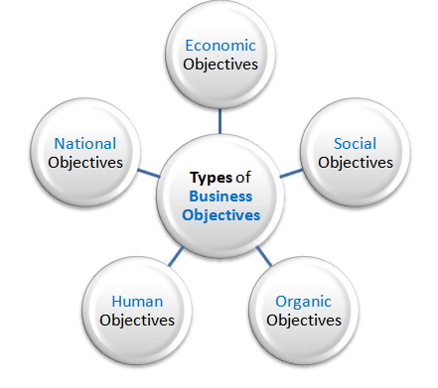
Objectives of business

Slide 23
Economic objective
ECONOMIC OBJECTIVES OF BUSINESS INCLUDES:
Earning profit
Creation of customers
Innovation
Best possible use of scarce resources

Slide 24
PROFIT EARNING
Profit is the like blood of business, without which no business can survive in a competitive market . Infact profit making is the primary objective for which a business unit is brought into existence.
Profits must be earned to ensure the survival of business, its growth and expansion over time.
Profits help businessmen not only to earn their living but also to expand their business activities by reinvesting a part of the profits.
In order to achieve this primary objective, certain other objectives are also necessary to be pursued by business, which are as follows:
Notes:
Economic Objectives :
Economic objectives of business include earning adequate profit or satisfactory
return on capital invested, survival in the case of competition and growth to
maintain progress

Slide 25
CREATION OF CUSTOMERS
A business unit cannot survive unless there are customers to buy the products and services.
Again a businessman can earn profits only when he/she provides quality goods and services at a reasonable price. For this it needs to attract more customers for its existing as well as new products.
REGULAR INNOVATIONS
Innovation means changes, which bring about improvement in products, process of production and distribution of goods.
Business units, through innovation, are able to reduce cost by adopting better methods of production and also increase their sales by attracting more customers because of improved products.
Reduction in cost and increase in sales gives more profit to the businessman. Use of power-looms in place of handlooms, use of tractors in place of hand implements in farms etc. are all the results of innovation.

Slide 26
BEST POSSIBLE USE OF RESOURCES
As you know, to run any business you must have sufficient capital or funds. The amount of capital may be used to buy machinery, raw materials, employ men and have cash to meet day-to-day expenses.
Thus, business activities require various resources like men, materials, money and machines.
The availability of these resources is usually limited. Thus, every business should try to make the best possible use of these resources.
This objective can be achieved by employing efficient workers, making full use of machines and minimizing wastage of raw materials.

Slide 27
SOCIAL OBJECTIVES
Social objectives are those objectives of business, which are desired to be achieved for the benefit of the society.
Since business operates in a society by utilizing its scarce resources, the society expects something in return for its welfare. No activity of the business should be aimed at giving any kind of trouble to the society. If business activities lead to socially harmful effects, there is bound to be public reaction against the business sooner or later.
Social objectives of business include production and supply of quality goods and services, adoption of fair trade practices and contribution to the general welfare of society and provision of welfare amenities.
Notes:
Social Objectives:
Social objectives include providing employment opportunities, supply of quality
goods and services at reasonable price, improving the standard of living and
contributing to environmental protection. It also includes justice to workers
in terms of wages, welfare amenities, improved service conditions and
professional growth.

Slide 28
PRODUCTION AND SUPPLY OF QUALITY GOODS AND SERVICES
Since the business utilizes the various resources of the society, the society expects to get quality goods and services from the business.
The objective of business should be to produce better quality goods and supply them at the right time and at a right price. It is not desirable on the part of the businessman to supply adulterated or inferior goods which cause injuries to the customers.
They should charge the price according to the quality of the goods and services provided to the society.
Again, the customers also expect timely supply of all their requirements. So it is important for every business to supply those goods and services on a regular basis.

Slide 29
ADOPTION OF FAIR TRADE PRACTICES
In every society, activities such as black-marketing and over-charging are considered undesirable.
Besides, misleading advertisements often give a false impression about the quality of products. Such advertisements deceive the customers and the businessmen use them for the sake of making large profits. This is an unfair trade practice.
The business unit must not create artificial scarcity of essential goods or raise prices for the sake of earning more profits.
All these activities earn a bad name and sometimes make the businessmen liable for penalty and even imprisonment under the law.

Slide 30
CONTRIBUTION TO THE GENERAL WELFARE OF THE SOCIETY
Business units should work for the general welfare and upliftment of the society.
This is possible through running of schools and colleges for better education, opening of vocational training centers to train the people to earn their livelihood, establishing hospitals for medical facilities and providing recreational facilities for the general public like parks, sports complexes etc.

Slide 31
SOCIAL OBJECTIVE
Generation of employment
Welfare of employees
Avoidance of slums & pollution
Contributing to general welfare of society

Slide 32
HUMAN OBJECTIVES
Human objectives refer to the objectives aimed at the well-being as well as fulfillment of expectations of employees as also of people who are disabled, handicapped and deprived of proper education and training.
The human objectives of business may thus include economic well-being of the employees, social and psychological satisfaction of employees and development of human resources.
ECONOMIC WELL BEING OF THE EMPLOYEES
In business employees must be provided with fair remuneration and incentives for performance, benefits of provident fund, pension and other amenities like medical facilities, housing facilities etc. By this they feel more satisfied at work and contribute more for the business.

Slide 33
SOCIAL AND PSYCHOLOGICAL SATISFACTION OF EMPLOYEES
It is the duty of business units to provide social and psychological satisfaction to their employees.
This is possible by making the job interesting and challenging, putting the right person in the right job and reducing the monotony of work.
Opportunities for promotion and advancement in career should also be provided to the employees.
Further, grievances of employees should be given prompt attention and their suggestions should be considered seriously when decisions are made.
If employees are happy and satisfied they can put their best efforts in work.

Slide 34
DEVELOPMENT OF HUMAN RESOURCES
Employees as human beings always want to grow. Their growth requires proper training as well as development.
Business can prosper if the people employed can improve their skills and develop their abilities and competencies in course of time.
Thus, it is important that business should arrange training and development programmes for its Employees.

Slide 35
WELL BEING OF SOCIALLY AND ECONOMICALLY BACKWARD PEOPLE
Business units being inseparable parts of society should help backward classes and also people those are physically and mentally challenged. This can be done in many ways:
For instance, vocational training programme may be arranged to improve the earning capacity of backward people in the community.
While recruiting it staff, business should give preference to physically challenged persons.

Slide 36
Human objective
Provide fair remuneration to employees in terms of salary & wages
Provide good working conditions
Provide growth opportunities to the employees
Provide training and development programmes to employees
Help society and economically backward people & handicapped persons.

Slide 37
NATIONAL OBJECTIVES
Being an important part of the country, every business must have the objective of fulfilling national goals and aspirations.
The goal of the country may be to provide employment opportunity to its citizen, earn revenue for its exchange, become self-sufficient in production of goods and services etc.
Business activities should be conducted keeping these goals of the country in mind, which may be called national objectives of business. The following are the national objectives of business.
CREATION OF EMPLOYMENT
One of the important national objectives of business is to create opportunities for gainful employment of people.
This can be achieved by establishing new business units, expanding markets, widening distribution channels, etc.
Notes:
National Objectives
Being an important part of the country, every business must have the objective of fulfilling
national goals and aspirations. The goal of the country may be to provide employment
opportunity to its citizen, earn revenue for its exchequer, become self-sufficient in production
of goods and services, promote social justice, etc. Business activities should be conducted
keeping these goals of the country in mind, which may be called national objectives of
business. The following are the national objectives of business.
Human Objectives
! Economic well
being of the
employees
! Social and
psychological
satisfaction of
employees
! Development of
human resources
! Well being of
socially and
economically
backward people
Business Studies
32
i. Creation of employment
One of the important national objectives of business is to create opportunities for gainful
employment of people. This can be achieved by establishing new business units, expanding
markets, widening distribution channels, etc.
ii. Promotion of social justice
As a responsible citizen, a businessman is expected to provide equal opportunities to all
persons with whom he/she deals. He/She is also expected to provide equal opportunities to
all the employees to work and progress. Towards this objective special attention must be
paid to weaker and backward sections of the society.
iii. Production according to national priority
Business units should produce and supply goods in accordance with the priorities laid down
in the plans and policies of the Government. One of the national objectives of business in our
country should be to increase the production and supply of essential goods at reasonable
prices.
iv. Contribute to the revenue of the country
The business owners should pay their taxes and dues honestly and regularly. This will increase
the revenue of the government, which can be used for the development of the nation.
v. Self-sufficiency and Export Promotion
To help the country to become self-reliant, business units have the added responsibility of
restricting import of goods. Besides, every business units should aim at increasing exports
and adding to the foreign exchange reserves of the country.

Slide 38
PROMOTION OF SOCIAL JUSTICE
As a responsible citizen, a businessman is expected to provide equal opportunities to all persons with whom he/she deals.
He/She is also expected to provide equal opportunities to all the employees to work and progress.
Towards this objective special attention must be paid to weaker and backward sections of the society.
PRODUCTION ACCORDING TO NATIONAL PRIORITY
Business units should produce and supply goods in accordance with the priorities laid down in the plans and policies of the Government.
One of the national objectives of business in our country should be to increase the production and supply of essential goods at reasonable prices.

Slide 39
CONTRIBUTE TO THE REVENUE OF THE COUNTRY
The business owners should pay their taxes and dues honestly and regularly.
This will increase the revenue of the government, which can be used for the development of the nation.
SELF-SUFFICIENCY AND EXPORT PROMOTION
To help the country to become self-reliant, business units have the added responsibility of restricting import of goods. Besides, every business units should aim at increasing exports and adding to the foreign exchange reserves of the country

Slide 40
National objective
To promote social justice
To produce according to national priorities
To increase exports
To find better substitutes for imports

Slide 41
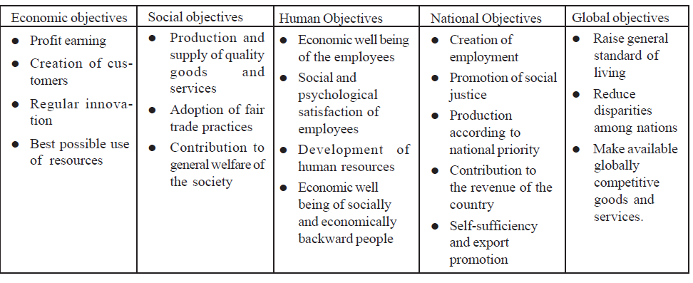
Classification of Objectives of Business
Notes:
Classification of Objectives of Business
It is generally believed that a business has a single objective, that is, to make profit. But it
cannot be the only objective of business. While pursuing the objective of earning profit,
business units do keep the interest of their owners in view. However, any business unit
cannot ignore the interests of its employees, customers, the community, as well as the interests
of society as a whole.
For instance, no business can prosper in the long run unless fair wages are paid to the
employees and customer satisfaction is given due importance. Again a business unit can
prosper only if it enjoys the support and goodwill of people in general. Business objectives
also need to be aimed at contributing to national goals and aspirations as well as towards
international well-being. Thus, the objectives of business may be classified as -
a. Economic Objectives
b. Social Objectives
c. Human Objectives
d. National Objectives
e. Global Objectives
Now we shall discuss all these objectives in details.
3.4 Intext Questions 3.1
Given below are some statements relating to the economic objectives of business.
Some statements are true and some are false. Identify the true statements:
i Creation of demand for goods is the primary objective of business.
ii. Profits are expected to be earned by businessmen in proportion to the amount
of capital invested in business.
iii. It is not always necessary for businessmen to make the best possible use of
materials.
iv. Businessmen should use profits earned from the business only for their own
living.
v. Generation of employment is the primary economic objective of business.
Intext Questions 3.2
Which of the following statements relating to social objectives of business are right and
which are wrong?
i) Social objective of business is based on the assumption that what is good for business
is also good for society.
ii) Production and supply of quality goods to the consumer is the social objective of
business.
iii) Creation of demand for the product is a social objective of business.
iv) Establishment of sports complex for the public is the economic objective of business.
v) Hoarding and black-marketing are considered desirable on the part of business.
3.6.
Intext Questions 3.3
Below are given some statements regarding human objectives of business. State which of
them are “true” and which are “false”:
i. Businessmen should pay proper remuneration which will motivate the workers for
work.
ii. Business units should provide social and psychological satisfaction to the employees.
iii. Businessmen should not help disabled persons unless they are employed in business.
iv. Business units should ignore the suggestions given by the employees while taking
important decisions.
v. Helping physically handicapped persons in the society is an economic objective of
business.
3.7
Intext Questions 3.4
Fill in the blanks with suitable word(s) from those given in brackets:
(i) To produce and distribute essential goods at a reasonable price is a/an _____________
objective of business. (social, national, human)
(ii) To help the country to become self-reliant business units should aim at increasing
________________. (export import, prices)
(iii) Business units should pay taxes honestly and______________.(occasionally, frequently,
regularly)
(iv) Business should provide equal opportunities to all its ________________.(owners,
employers, suppliers)
3.8

Slide 42
BUSINESS ACTIVITIES
Industry includes all those activities which are connected with raising , producing or processing of goods.
Business activities range from making the materials available for production of goods to actual production of goods and then making the goods available for distribution.

Slide 43
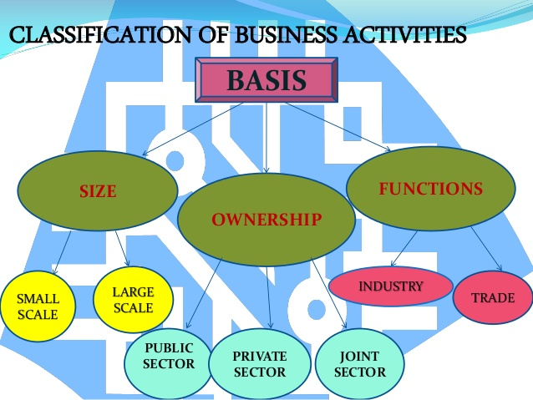

Slide 44
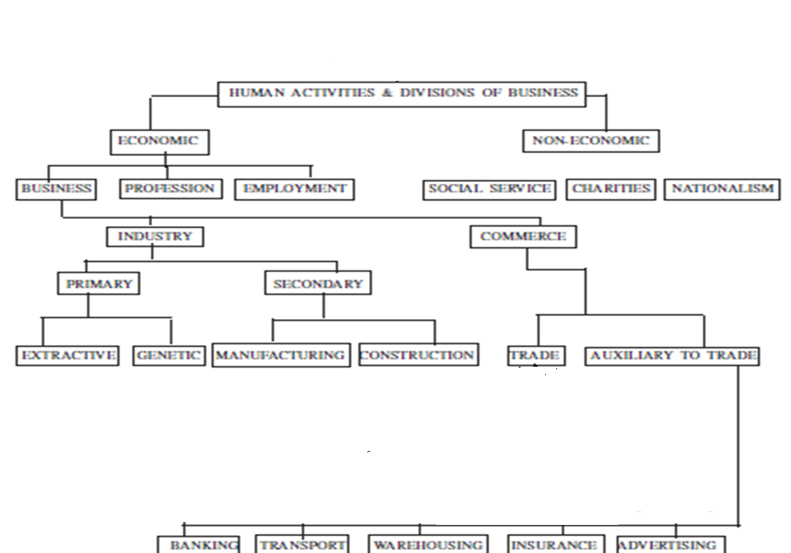

Slide 45
Industry
Commerce
Business activities
Industry refers to economic activities which are connected with conversion of resources into useful goods.
Commerce includes all those activities which are necessary for facilitating the exchange of goods and services.

Slide 46
INDUSTRY AND COMMERCE
Industry :is that branch which is concerned with the production of good & services .the term industry is used to refer to useful things that are extracted from environment and transformed ,processed , and multiplied into other products
Commerce :is concerned with the exchange of goods & services ,with all that is involved buying & selling of goods (conversion of raw materials to finished good on consumer hands )

Slide 47
INDUSTRY
PRIMARY
TERTIARY INDUSTRY
SECONDARY INDUSTRY

Slide 48
PRIMARY INDUSTRY
EXTRACTIVE
FARMING
MINING
FISHING
GENETIC
CATTLE BREEDING FARMS
POULTRY FARMS
These industries extract or draw out various products from natural resources.
Genetic means heredity or parentage. These industries involve breeding or reproduction of plants and animals.

Slide 49
PRIMARY INDUSTRY
Primary Industries : It involves the extraction of raw materials from the Earth. Primary businesses and industries are those which extract (i.e. mine, farm, fish or drill) things normally provided by nature, e.g. ~ fish from the sea; ~ metal from the earth; ~ food from the land. They produce raw materials in the form of oil, iron, coal or limestone, which are used to make other products.
Extractive Industry :These industries extract or draw out products from natural sources such as earth ,soil ,water ,air etc
Examples: Farming ,mining ,Hunting ,fishing etc
Genetic Industry :means parentage or hereditary .Genetic Industries are engaged in multiplying or reproduction of certain species of plants & animals
Example: Cattle breeding farms, poultry farms ,fish farms

Slide 50
Secondary industry
MANUFACTURING INDUSTRY
These industries convert raw materials or semi-finished products into finished products.
Analytical industry: basic raw material is analysed or separated into a number of products.
CONSTRUCTION INDUSTRIES
Synthetical industry: two or more materials are combined or mixed together to manufacture a new product.
Processing industry: involves successive stages for manufacturing finished products.
An oil refinery separates crude oil into kerosene, diesel, petrol.
Cement, plastics, paints, fertilizers etc.
Sugar, paper
Assembling industry: various components or parts are brought together to produce a finished product
TV, car, computer, watches etc.
Engaged in construction of buildings, bridges, roads, dams etc

Slide 51
Secondary Industries :Secondary businesses and industries are those involved in manufacturing products. That is, they turn the raw materials produced by the primary industries into things that can be sold and used. e.g. ~ metal into cars ~ wood into furniture ~ wheat into bread
MANUFACTURING INDUSTRIES :these industries are concerned with conversion of raw material & semi finished products into finished products .They create form Utility
Analytical :The Basic material is analyzed & separated into a number of products .Oil refinery-crude oil is extracted from beneath the earth and is processed into petrol ,diesel ,kerosene ,gasoline ,lubricating oil etc .
Syntactical: Two or more products mixed together in the manufacturing operations to obtain some new products :example Soap ,cement ,paints ,fertilizers ,cosmetics etc

Slide 52
Processing: Raw ,materials are processed through a series of manufacturing operations .
examples-textile sugar ,steel
Assembling :various components or parts are brought together to produce finished products.
example- Manufacture of Radio ,bicycle , TV , Watches automobiles etc
CONSTRUCTION INDUSTRIES
They are concerned with making of Buildings ,bridges ,dams ,roads ,canal etc

Slide 53
TERTIARY
Tertiary industries includes all those activities which are concerned with providing services such as banking , insurance , warehousing ,advertising ,transportation etc
Notes:
Include a definition and picture

Slide 54
commerce
TRADE
Trade refers to buying and selling of goods and services with the objective of earning profit.
AUXILIARIES TO TRADE
Activities which are meant for assisting trade are known as auxiliaries to trade.

Slide 55
COMMERCE
The term commerce refers to the process of buying and selling (wholesale; retail, import, export )and all those activities which facilitate or assist in such buying and selling such as storing, packaging, finance, transporting, insuring, communicating, warehouse etc.
The main functions is to remove the hindrance of :
person through trade,
place through transporting insurance and packing
time through warehousing and storage
Knowledge through salesmanship, advertising etc. arising in connection with the distribution of goods and services until they reach the consumers.
The concept of commerce includes two types namely
1. Trade and
2. Aids to trade

Slide 56
TRADE
The term trade refers to the sale, transfer or exchange of good and services and constitute the central activity around which the ancillary functions like banking, transporting, insurance, packaging, warehousing and advertising cluster. Trade may be classified into two broad categories as follows:
Internal or domestic trade::
It consists of buying and selling of goods within the boundaries of a country and the payment for the same is made in national currency either directly or through the banking system. Internal trade may be further sub classified into wholesale trade and retail trade.
International or foreign trade
It refers to the exchange of goods and servies between two or more countries.

Slide 57
Types of trade
Wholesale
trade
Retail
trade
External trade: which takes place between two or more countries.
Import trade
Export trade
Internal trade: which takes place within a country
If goods and services are sold to other countries, it is called export trade.
If goods are purchased from another country, it is called import trade.
Retail trade refers to buying of goods and services in relatively small quantities; and selling them to ultimate consumers.
Wholesale trade refers to buying and selling of goods and services in large quantities for the purpose of resale or intermediate use.

Slide 58
AUXILIARY TO TRADE OR AIDS TO TRADE
There are certain factions such as banking, transportation, insurance, ware- housing, advertising etc. which constitute the main auxiliary function helping trade-internal and international. These auxiliary functions have been briefly discussed hereunder:
Banking
Banks provide a device through which payments for goods bought and sold are made thereby facilitating the purchase and sale of goods on credit. Banks serve the useful economic functions of collecting the saving of the people and business houses and making them available to those who may profitably use them. Thus banks may be regarded as traders in money and credit.
Transportation
Transport performs the functions of carrying goods from producers to wholesalers, retailers and finally customers.

Slide 59
Warehousing
There is generally a time lag between the production and consumption of goods. This problem can be solved by storing the goods in warehouse. Storage creates time utility and removes the hindrance of time in trade.
It performs the useful function of holding the goods for the period from one point to another. Thus, warehousing discharges the functions of storing the goods both for manufactures and traders for such time till they decide to move the goods from one point to another.
Insurance
Insurance provides a cover against the loss of goods in the process of transit and storage. An Insurance company performs a useful services of compensating for the loss arising from the damage caused to goods through fire.

Slide 60
Advertising
Advertising performs the functions of bridging the information gap about the availability and uses of good between traders and consumers. In the absence of advertising goods would not have been sold to a widely scattered market and customers would not have come to know about many of the new products.

Slide 61
AUXILIARIES TO TRADE
Transport and communication
Banking and finance
Warehousing
Transport(road,rail or coastal) facilitates movement of –raw materials to the place of production , and the finished goods from factories to the place of consumption
Business needs funds for acquiring assets, purchasing raw materials and meeting day-to-day expenses.
Communication facilities like postal services and telephone facilities enable businessmen to exchange information with one another.
It refers to the holding and preservation of goods until they are finally consumed.
Advertising
Necessary funds can be obtained by businessmen from commercial banks.
Thus banking helps business activities overcome the problem of finance.
It helps business firms to overcome the problem of storage of goods and facilitates the availability of goods when needed.
Warehousing creates time utility.
Advertising brings goods and services to the knowledge of prospective buyers.
With the help of such knowledge, consumers can obtain better value for their money
Thus, advertising helps to promote the sale of products like electronic goods, automobiles, soaps etc by providing information about them.

Slide 62
Requisites of Success in Modern Business
&
Qualities of a Successful Businessman

Slide 63
REQUISITES OF SUCCESS IN MODERN BUSINESS
Clear –cut Objectives
Efficient Business planning
Proper Size Location ,and Layout
Financial Planning
Marketing network
Executive Development
Human Relations
Research & Development

Slide 64
Qualities Of A Successful Businessman
Wide Knowledge
Initiative
Business Morality
Ability to cooperate
Self-Confidence
Aptitude for research & Analysis
Winning Personality

Slide 65
QUALITIES OF A SUCCESSFUL BUSINESS
Independent
Risk bearing
Openness to feedback & learning from Experience
Notes:
Besides the above traits, the most important qualities of a business are as follows:
Initiative and capacity to take prompt decision: Now-a-days, things move very fast and as such the businessman should have the capacity to take initiative and prompt decision.
Determination, courage and perseverance: He must have strong will power and determination. He must have courage and perseverance to face the initial and future problems of the business.
Intelligence and alertness: The businessman should be alert to his surroundings and he must be aware of the possible changes otherwise he will fail in business. He should be intelligent enough to utilize business opportunities.
Quality of leadership: He should have the quality of leadership because today's business require loyalty and co-operation of all employees.
Morality and integrity: The businessman should be honest, straight-forward, fair in dealings, dependability, and moral character. If a businessman intends to make money in a dishonest manner, he cannot establish in business for a long period.
Training and Education: The businessman should learn the intricacies of modern business through training and education. These are thus essential for a successful businessman.
Besides the above qualities, the businessman should posses the qualities of tact, patience, foresight, frankness, common sense and charming.
Characteristics you need to be successful as an entrepreneur
The 12 letters of the word 'Entrepreneur' can best describe the characteristics of a successful entrepreneur.
E - Enterprising: The first quality one must have is the readiness to undertake a project or business in which he/she believes in, even though it is untried or unpopular. N - Need to excel: Another characteristic of a successful Entrepreneur is a hunger for success or to be the best.A need to excel in their venture is a 'must - have' quality in a successful business man.
T - Talented - It goes without saying that all successful businessmen are talented and creative people.It is one of the basic reason for their success.
R - Risk Taking Ability - For an entrepreneur to be successful, the ability to take take calculated risks is very important.
E - Economic- An entrepreneur's success also depends in his ability to be economical.'Spend less and get more' attitude helps in reducing the financial burden of the project.
P - Perseverance - There are always 'ups' and 'downs' in running a business.But to overcome the difficulties and moving on despite the obstacles is a strong trait to have to be successful in business.
R - Relationship Expert - Building and maintaining relationships helps an entrepreneur sustain his business even in most difficult of times.
E - Energy - One must be healthy, energetic and fit to run a successful business.The fitness should not only be restricted to physical level but must also include mental strength.
N - Noisy - This means one has to publicize one's work.Effective Marketing and Communication to the customers and clients is very important.And the best person to do this job is the entrepreneur himself.If he has the ability to communicate his vision to the client or the customer half the battle is won.
E - Eye for details - Again a very important quality for a successful entrepreneur.Everybody knows that 'beauty lies in the details' and a person expert in this makes his customers happy.
U - Untouched by Greed - Many a businesses have failed due to greed.Once one starts doing well and earning money they misuse the trust of the customers in order to earn more money.But if one is able to remain balanced and let not money control their emotions they have much brighter chances to earn money and good reputation.
R - Religious - Religion is 'faith'.It does not necessarily mean to go to the church or temple or any other place of worship.One can have faith in anything.And one must keep that faith.An entrepreneur can only move forward in life & be successful if he keep the faith on, even during darkest of moments.
The businessman to be successful in his business should have certain basic qualities. Businessmen also include office managers in sole trading firm and professional managers in case of company. An important authority has attributed certain traits of a successful businessman. These traits are:
Physical and nervous energy
Sense of purpose
Integrity
Friendliness
Intelligence
Enthusiasm
Technical mastery
Technical skill
Decisiveness
Faith

